Slide 1

Automatic Concept Map Generation from Text-based Learning Material
Language Processing for E - Learning (ET61002)
Presented By Under the Guidance of Ekka Laveen Mathias Prof. Plaban K. Bhowmick Sumit Verma
Umang Chaturvedi
Vikash Kumar Chaurasia

Slide 2
Concept Map
Conceptual diagram to represent relationship between concepts
More Formally, It is a graph G = (V, E), where V is a set of all the concepts and E is a set of relationship between concepts.
Presents concise overview of a learning material

Slide 3
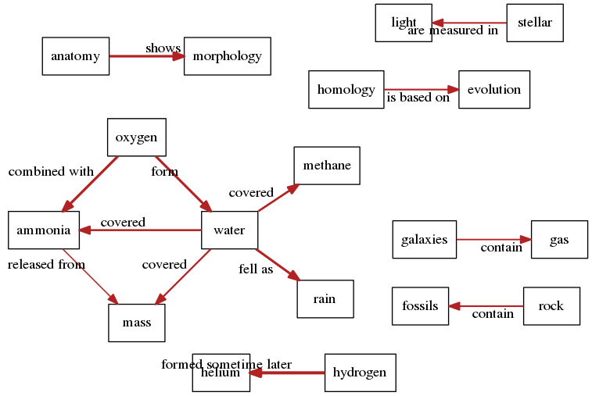
Concept Map For Evolution

Slide 4
Workflow
Concept Extraction
Concept Similarity
Filtering Unrelated Pairs
Extract Relations
Computation of Relation Strength
Visualization Interface

Slide 5
Concept Extraction
Concept Similarity
Filtering Unrelated Pairs
Extract Relations
Computation of Relation Strength
Visualization Interface
Dbpedia Spotlight - Tool for automatically annotating mentions of DBpedia resources in a text
Example : “Python is an interpreted high-level programming language for general-purpose programming.”
Concepts: Python, high-level programming language, general-purpose programming
REST API Call To “http://api.dbpedia-spotlight.org/en/annotate”
which takes text as parameter

Slide 6
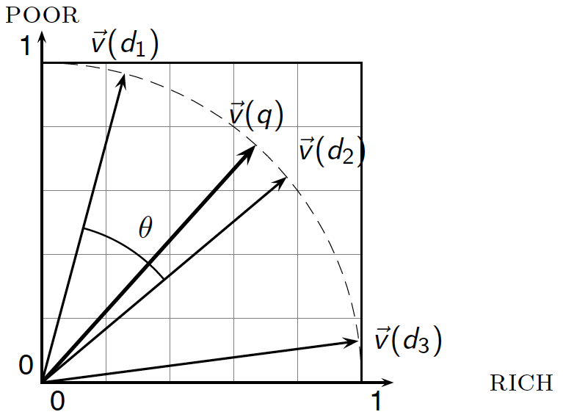
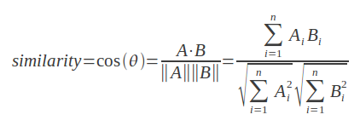
Concept Extraction
Concept Similarity
Filtering Unrelated Pairs
Extract Relations
Computation of Relation Strength
Visualization Interface
Measures the similarity between concepts
For example: To calculate similarity between concept POOR and RICH we first represent this words in vector form and finally compute similarity between them using formula :-

Slide 7
Concept Extraction
Concept Similarity
Filtering Unrelated Pairs
Extract Relations
Computation of Relation Strength
Visualization Interface
Filtering out the concept pairs having similarity score below the threshold
concept 1 | concept 2 | 0.01
concept 1 | concept 3 | 0.04
concept 2 | concept 3 | 0.5
0.05
concept 2 | concept 3 | 0.5

Slide 8
Concept Extraction
Concept Similarity
Filtering Unrelated Pairs
Extract Relations
Computation of Relation Strength
Visualization Interface
Open IE - Tool for extracting relation tuple (Subject , Relation, Object)
Example :
“Python is an interpreted high-level programming language.”
Tuple : (Python; is an; interpreted high-level programming language)
Open Domain Relation : is an(Python, interpreted high-level programming language)

Slide 9
Concept Extraction
Concept Similarity
Filtering Unrelated Pairs
Extract Relations
Computation of Relation Strength
Visualization Interface
Relation Strength - Funtion of cosine similarity between two associated concepts.

Slide 10
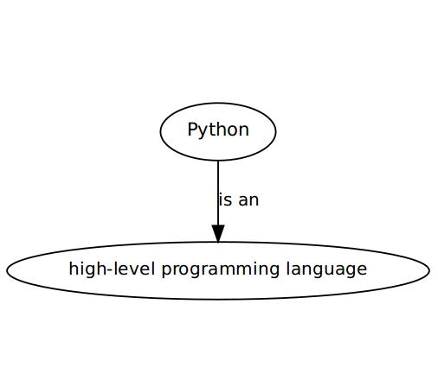
Concept Extraction
Concept Similarity
Filtering Unrelated Pairs
Extract Relations
Computation of Relation Strength
Visualization Interface
Garphviz - Tool for visualization
Node - Concept
Edge - Relation
Weight - Strength of Relation
Example : “Python is an interpreted high-level programming language.”

Slide 11
Concept Map For Evolution

Slide 12
References
pyspotlight: https://pypi.python.org/pypi/pyspotlight/0.7.1
Entry of Charles Darwin
Pre-trained word vectors: http://nlp.stanford.edu/data/glove.6B.zip
https://pypi.python.org/pypi/GephiStreamer

Slide 13


Slide 14
